Slide 1
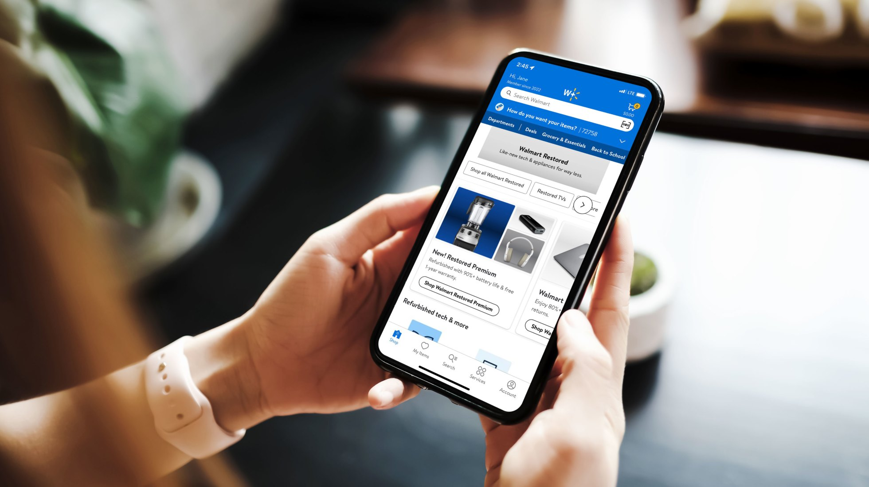
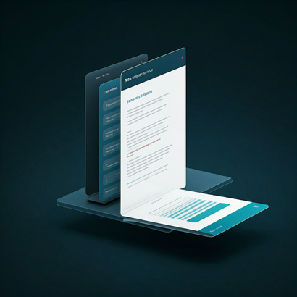


MyAssistant
People.AI, Enterprise Business Services
MyAssistant Experience
MyAssistant Experience
Page Reader Plugin
Outlook Add-in
IDC Demo Day— 2025
Notes:
Slide 1
Today, we have the privilege of presenting the product demo for MyAssistant.
We began our journey approximately a year ago, and over time, MyAssistant has successfully established its own identity and become an integral part of the daily work of Walmart associates.
Over the past few months, we have conducted extensive campaigns and demonstrations for this product. Last year, we also presented MyAssistant at Demo Day. Rather than revisiting the same content, I will focus on the current areas we are prioritizing and the features planned for the coming months.
Specifically, we will discuss two experiences: the "Ask My Page" feature and the Outlook plugin of "MyAssitant"

Slide 2
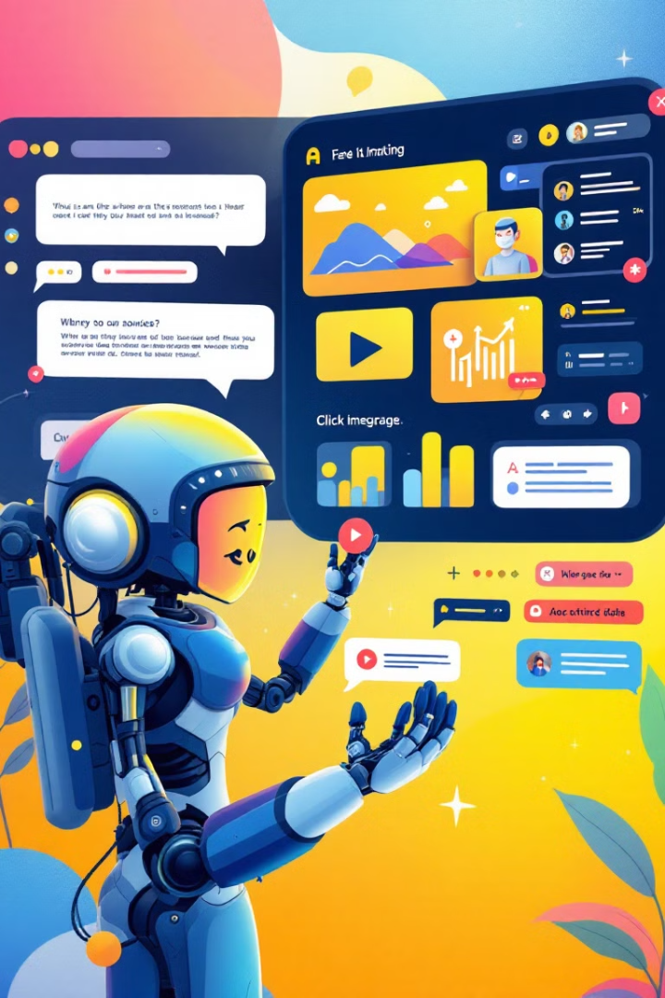







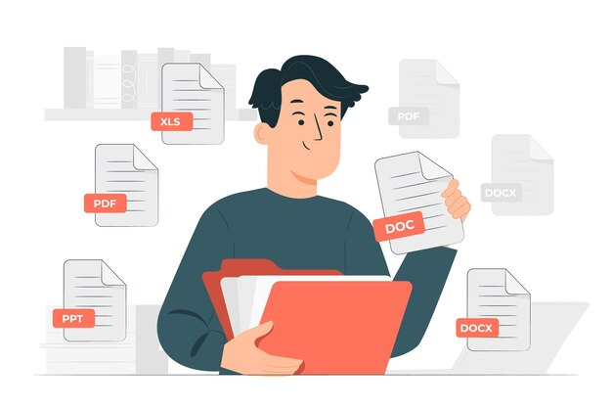

MyAssistant Overview
Internally managed Gen AI Platform to drive Associate Productivity for 2.1 million Walmart associates.
Maintain Walmart Privacy
Conventional ChatBot
Power of AI
Walmart Knowledge
Conventional ChatBot
Power OF AI
Walmart Knowledge
Personalized Experience
Domain specific Information
Quick, intuitive answer
Advantages
Upload and ask questions on any document
Predesigned Questions
Notes:
For those who are learning about MyAssistant for the first time, allow me to briefly outline its core functionalities.
MyAssistant is built upon three foundational pillars: a traditional chatbot, advanced AI capabilities, and Walmart-specific knowledge training.
Its unique selling proposition (USP) is its secure environment tailored specifically for Walmart associates.
The MyAssistant experience is highly personalized, enabling associates to ask questions and receive prompt, intuitive responses.
Leveraging domain-specific knowledge, MyAssistant can be contextualized to address the unique requirements of our associates.
It also offers the ability to upload documents, ask related questions, obtain summaries, and retrieve precise information. Moreover, it allows associates to refer to Walmart policies and seamlessly explore business data.

Slide 3








MyAssistant Overview
Internally managed Gen AI Platform to drive Associate Productivity for 2.1 million Walmart associates.
Features
6. Operate Independently
Building Blocks
Conventional ChatBot
Power OF AI
Walmart Knowledge
Release Countries
US
India
Canada, Mexico & other international markets.
1. MyAssistant working as a Platform and experiences are building block.
5. Role Based enablement.
15,000+ weekly active Users
2. Support “Bring your Own Experience”
Channels
4. Market Parity.
3. Design to solve a specific user problem
Standalone
Me@Campus,
Me@Sams
Browser Extension
Outlook Addin*
Teams and Slack
Notes:
My Assistant Overview
Remove: Plugin and Agent
Add: Markets (International Parity → Language Parity) and Add: Usage: 15WAU
Focus on Homeoffice Associates → Now we have started building experience for field associates as well )
Slide 4: Key Components of MyAssistant - Plugin and Agent
To understand the concept of Experience, it is essential to highlight two other components: Plugin and Agent.
As mentioned, an Experience represents a journey, whereas a Plugin is a component that drives the experience. In technical terms, it is a backend microservice developed for a specific purpose. Currently, plugins require explicit selection by the user. However, our goal is to transition to an Agentic approach, where experiences will be invoked implicitly.
There is a significant buzz around the Agentic approach, and we are early adopters of this methodology. We anticipate making it available to our colleagues in the coming months.
As of now, MyAssistant is available through several channels, including:
MyAssistant standalone application
Platform applications like Me@Campus and Me@Sams
Browser extensions, primarily for Edge and Chrome
Additionally, two more channels are in the pipeline:
Outlook Add-in
Teams and Slack integrations

Slide 4


MyAssistant Experiences
ASK ME DOC
ASSOCIATE CAN HAVE NATURAL LANGUAGE QUESTION ANSWERING ON UPLOADED DOCUMENTS AND GET INSIGHT
AES INSIGTS
MANAGERS CAN ANALYSE THEIR AND THEIR DIRECTS “AES” REPORT
CREATE PERFORMANCE GOAL
ASSOCIATES CAN USE AI TO CREATE PERFORMANCE GOALS FOR YEAR-END EVALUATION.
Agent Orchestrator
Experience
PEOPLE DATA EXPERIENCE
REAL-TIME ANALYTICS, INSIGHTS AND ACTIONS ON STORES AND ASSOCIATES
HELP ME WRITE
PROVIDE WALMART KNOWLEDGE WORKERS TO HAVE A BACK-AND-FORTH CONVERSATION AND AND EVENTUALY HELP TO WRITE CONTENT.
FIND WALMART INFO
USER CAN DO Q&A ON ALL WALMART KNOWLEDGE INFO., ONE WALMART POLICIES, SERVICE NOW KNOWLEDGE ONBOARDING x ETC.
Experiences will be selected implicitly based on user prompt.
Curated Flow designated to solve specific user problem
Notes:
My Assistant :
AES Insights: Managers to analyze their and their directs AES report
Find Walmart Info (100% of Walmart Knowledge Onboarding) → Users will be able do Q&A on all Walmart knowledge information. One.Walmart policies, SOPs, service now knowledge onboarding forms.
PDE: Analytics, Insights (HRBPS need real time analytics, insights and recommended actions for their area of responsibility)
Agent Orchestrator: We started with experiences as tiles in our initial design as users were on a learning curve to use GenAI. However, we are further advancing so that user
Slide 3: MyAssistant - A Transformative Experience Platform
The purpose of MyAssistant is to deliver a curated flow designed to solve specific purposes, creating a seamless and efficient user experience.
MyAssistant is not merely a chatbot; it functions as a comprehensive platform. It provides a framework that allows any team to bring their unique use cases and onboard dedicated experiences tailored to their specific areas and innovation journeys.
Several experiences are currently available, although we won't have time to cover all of them.
For instance, the "People Data Experience" provides detailed information about stores and their associates. This feature allows users to generate reports and analyze relevant trends. Associates can also set performance goals and search for HR information through MyAssistant.
By using MyAssistant, users are guided to write better content with Walmart-specific information, ensuring accuracy and consistency.

Slide 5
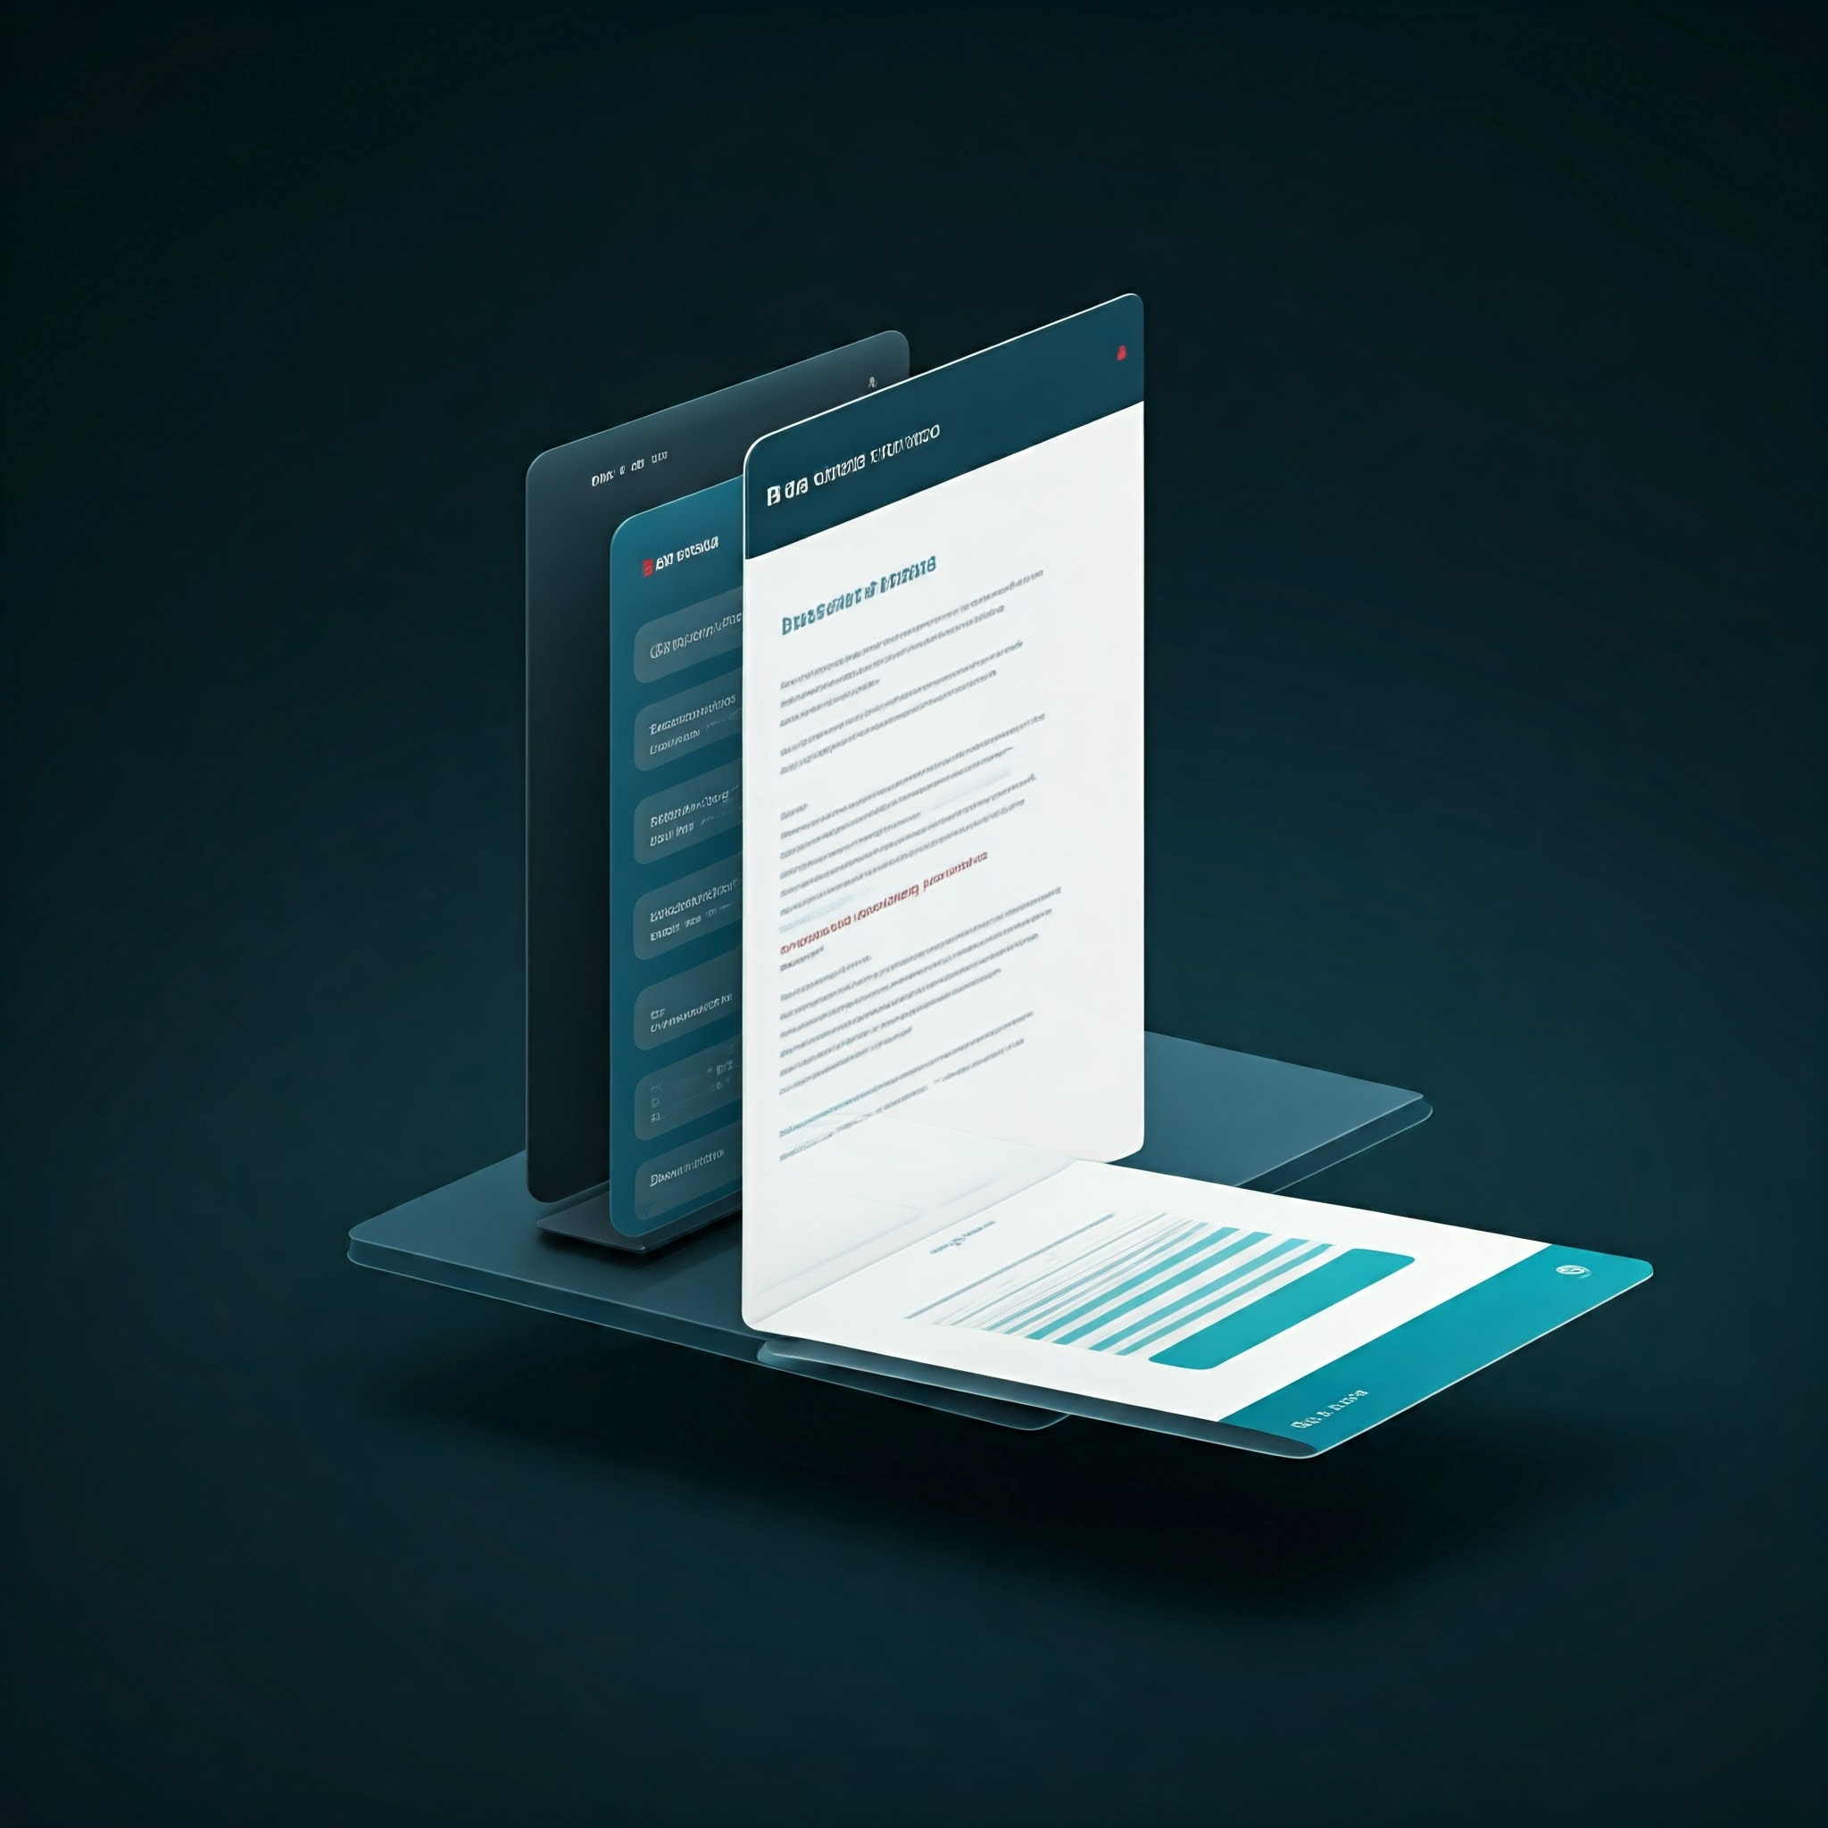











Ask My Page - Overview
MyAssistant Experience
My Assistant Browser Extension expands its capabilities to include ‘Read Actions’ to interact with webpages using My Assistant, extracting key points and identifying gaps in content directly in their browser.
Browser Extension
Page Reader Plugin
Key Features
Current Capabilities
MyAssistant currently analyzes text and tables within the current web page. This includes extracting key points, summarizing information, and generating FAQs.
MyAssistant Policy ensure that the user must be in Walmart Network and read the disclaimer and acknowledge the “terms and conditions” .
Summarizes web page content
Generates FAQs based on page content
Future Capabilities
2
Internet Search
Source Display
1
Multimodality
3
Answers user inquiries about the page
MyAssistant will soon support image processing, expanding its capabilities to analyze visual content and provide richer insights.
MyAssistant will go beyond the current page, expanding its boundaries to include web searches, providing comprehensive information and contextual understanding.
MyAssistant will clearly display sources and attribution, ensuring transparency and enhancing the reliability of information presented.
Ask relevant questions & proposes engaging prompts and actions
Notes:
Slide 5: Key Features of "Ask My Page"
In one line, "Ask My Page" processes entire web pages, provides summaries, enables Q&A, and aids in writing assignments and other documents with business information. It features summarization of the page, question and answer capabilities, and access to FAQs, serving various purposes like technical content writing and research. Engineers can use Confluence pages, Jira, ServiceNow pages, and more for their day-to-day work. Currently, it analyzes text and table data, and in the near future, it will support picture processing. Security measures are in place, requiring users to be on the Walmart network and VPN. Future capabilities will include multimodality, starting with image processing and expanding to internet searches, providing sources, links, and bibliographical references.

Slide 6
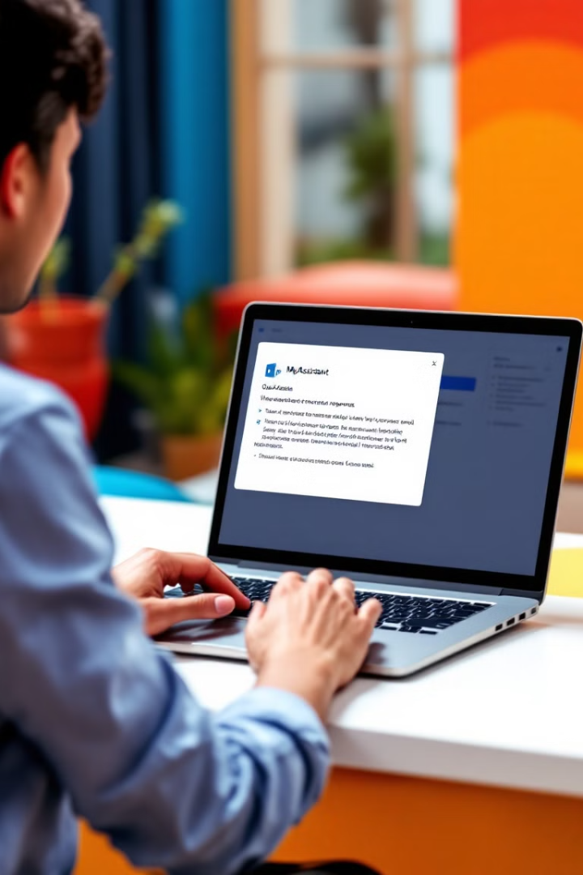










How ‘Ask My Page’ works?
Ingestion Flow
User Flow
Contains harmful/ sensitive info.
No processing
Web page from browser
Web scrapping
Content safety & PII moderation
No harmful/ sensitive info.
Ingestion to LLM for Q&A
Retrieval Flow
User query about the web page
Integration of User query and Web page content to LLM prompt
Web page content understanding using LLM
Response generation using LLM

Slide 7
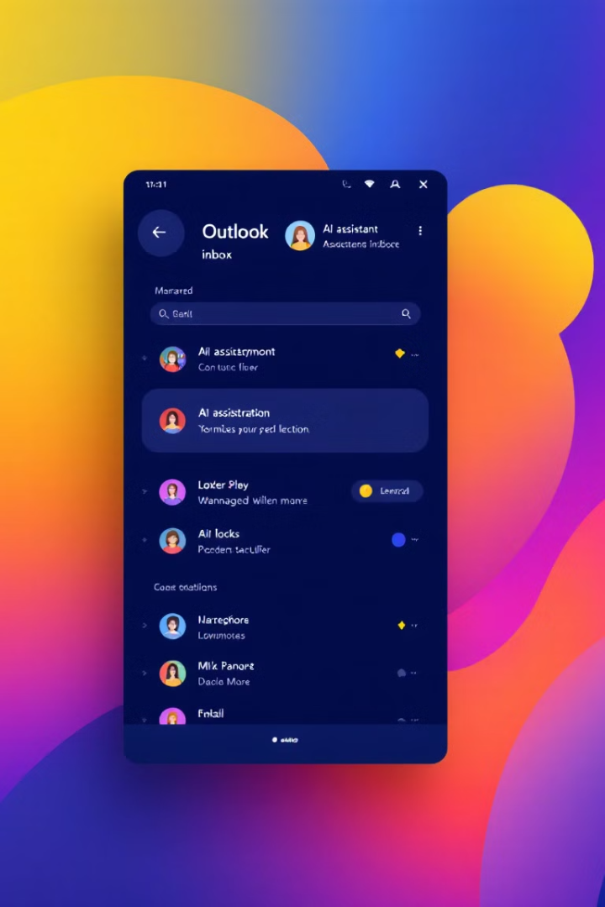










Channel - Outlook Add-in
MyAssistant Experience
Open Outlook
click “MyAssitant” icon
Open Email Chain
Email Summarization
Quickly grasp the main points of an email without reading the entire message. MyAssistant extracts key information and provides a concise summary.
Email Inquiry
Pass text to LLM
Content safety
& PII moderation
Text Extraction
Ask questions about the email content, and MyAssistant provides relevant answers based on the email thread. Responses are limited to the email context.
Smart Reply
The user reserves the right to take action based on any response provided by the language model.
MyAssistant suggests appropriate responses to emails, helping you quickly reply with relevant and informative content. Responses can include external context for more comprehensive replies.
Response generate through LLM

Slide 8




Safety, Accuracy Measures
MyAssistant: Ensuring Safety and Privacy
MyAssistant: Unleashing Productivity
Disclaimer Alert
Privacy Consent and Safeguard
Time Savings
Automate tasks, summarize content, and generate responses quickly. Get more done in less time, freeing up valuable hours.
Users will be clearly informed of MyAssistant's limitations, emphasizing that it is an AI tool and not a substitute for professional advice.
MyAssistant will require user consent before accessing or processing personal information, respecting data privacy and security.
Improved Understanding
Gain deeper insights from web pages and emails. Understand complex information more effectively, leading to better decisions and outcomes.
Content & PII Moderation
Responsible AI Evaluation
MyAssistant employs robust content moderation techniques to filter out inappropriate or harmful content and personally identifiable information, ensuring a safe and ethical experience also safeguarding user privacy and data security.
We have done extensive evaluation with huge data set and set our response accuracy standard high(95%) while also working closely with AI/ML Review team to follow Walmart’s Responsible AI guidelines.
Enhanced Collaboration
Communicate more effectively with colleagues and clients. Share accurate and insightful information, fostering stronger connections.
Notes:
Content and PII moderation.
MyAssistant Productiviy box - Remove

Slide 9
Safety, Accuracy Measures
MyAssistant: Ensuring Safety and Privacy
Content & PII Moderation
Responsible AI Evaluation
MyAssistant employs robust content moderation techniques to filter out inappropriate or harmful content and personally identifiable information, ensuring a safe and ethical experience also safeguarding user privacy and data security.
We have done extensive evaluation with huge data set and set our response accuracy standard high(95%) while also working closely with AI/ML Review team to follow Walmart’s Responsible AI guidelines.
Privacy Consent and Safeguard
Disclaimer Alert
MyAssistant will require user consent before accessing or processing personal information, respecting data privacy and security also not persist any user data.
Users will be clearly informed of MyAssistant's limitations, emphasizing that it is an AI tool and not a substitute for professional advice.
Notes:
Content and PII moderation.
MyAssistant Productiviy box - Remove

Slide 10




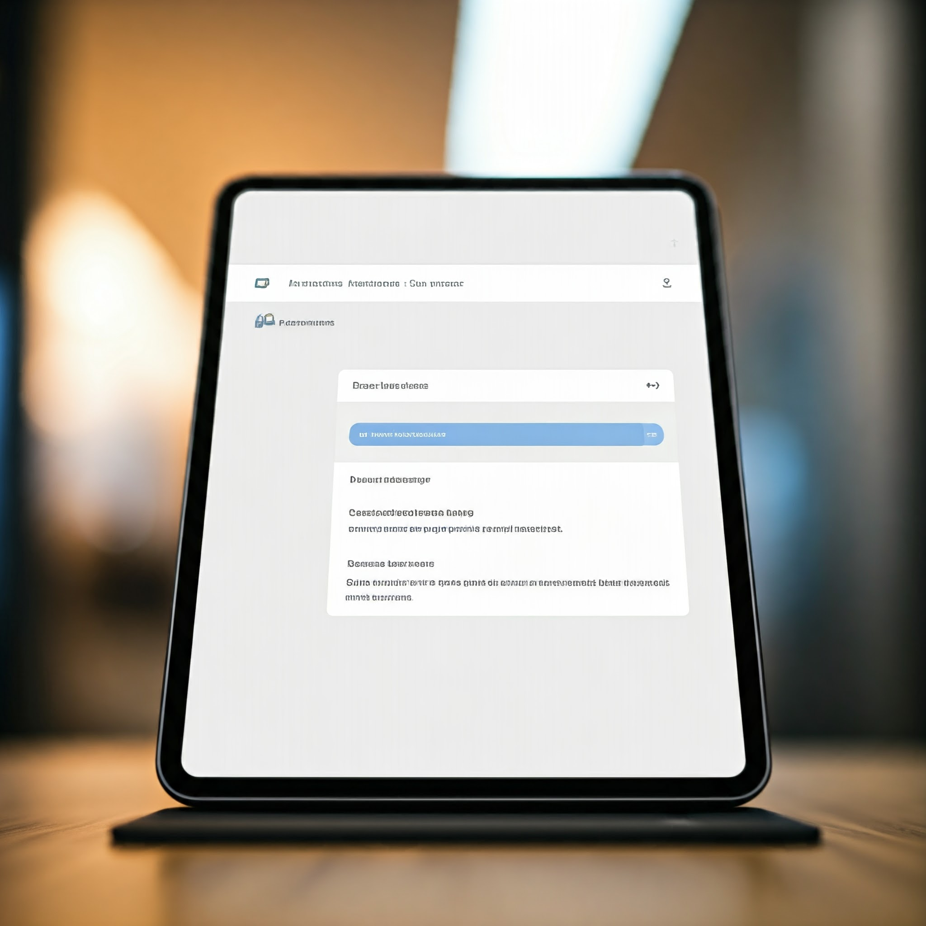
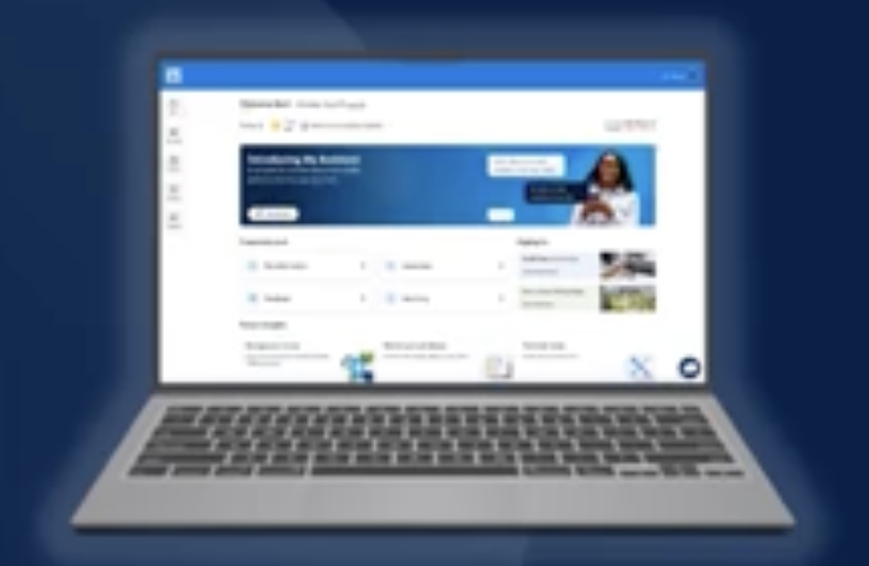
How can I get MyAssistant?
Standalone
https://myassistant.walmart.com/
Me@Campus
https://campus.walmart.com/home
10
Walmart Confidential
Notes:
Plugin represent a component whereas Experience represent a journey
Get detainis of stores also generate reports and analysis relevant trends.
Learn to prompt teach to get output which is most effective b teaching better prompting.
HMR: Guide user to write better content with Walmart information.

Slide 11
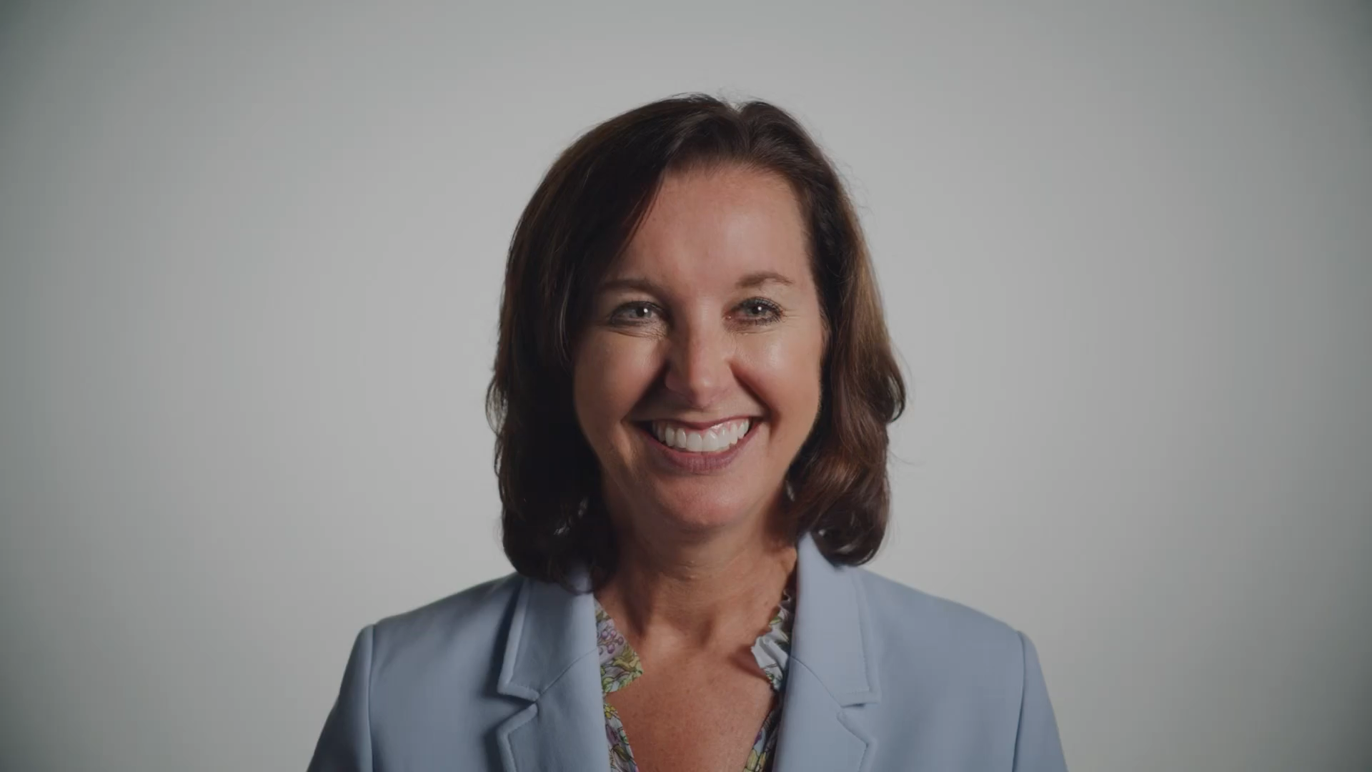
Helpful Links
RESOURCES

Slide 12
Summarizing and identifying key points from a webpage
Creating a list of FAQs tailored to the web page content
Responding to user inquiries related to the web page
Proposing engaging prompts or actions inspired by the web page

Slide 13


Ask My Page Deep Dive
User Flow
User Flow
Notes:
Browser Extension
Plugin represent a component whereas Experience represent a journey
Get detainis of stores also generate reports and analysis relevant trends.
Learn to prompt teach to get output which is most effective b teaching better prompting.
HMR: Guide user to write better content with Walmart information.

Slide 14


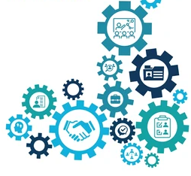
MyAssistant- Functional Excellence
Upload and ask questions on any document
Personalized Experience
Domain specific Information
Quick, intuitive answer
Marketplace
Hosted
Advantages
Predesigned Questions

Slide 15
Summarizing and identifying key points from a webpage
1
Creating a list of FAQs tailored to the web page content
2
Responding to user inquiries related to the web page
3
Proposing engaging prompts or actions inspired by the web page
4

Slide 16
What ‘MyAssistant’ provides additional?
6. Curated for End User
1. MyAssistant is working as a Platform
Experience
5. Role Based enablement.
2. Support “Bring your Own Experience”
4. Market Parity.
3. Agent orchestration
Curated Flow designated to solve specific user problem
Experience are how associates find Walmart information in My Assistant
Notes:
Plugin represent a component whereas Experience represent a journey
Get detainis of stores also generate reports and analysis relevant trends.
Learn to prompt teach to get output which is most effective b teaching better prompting.
HMR: Guide user to write better content with Walmart information.

Slide 17
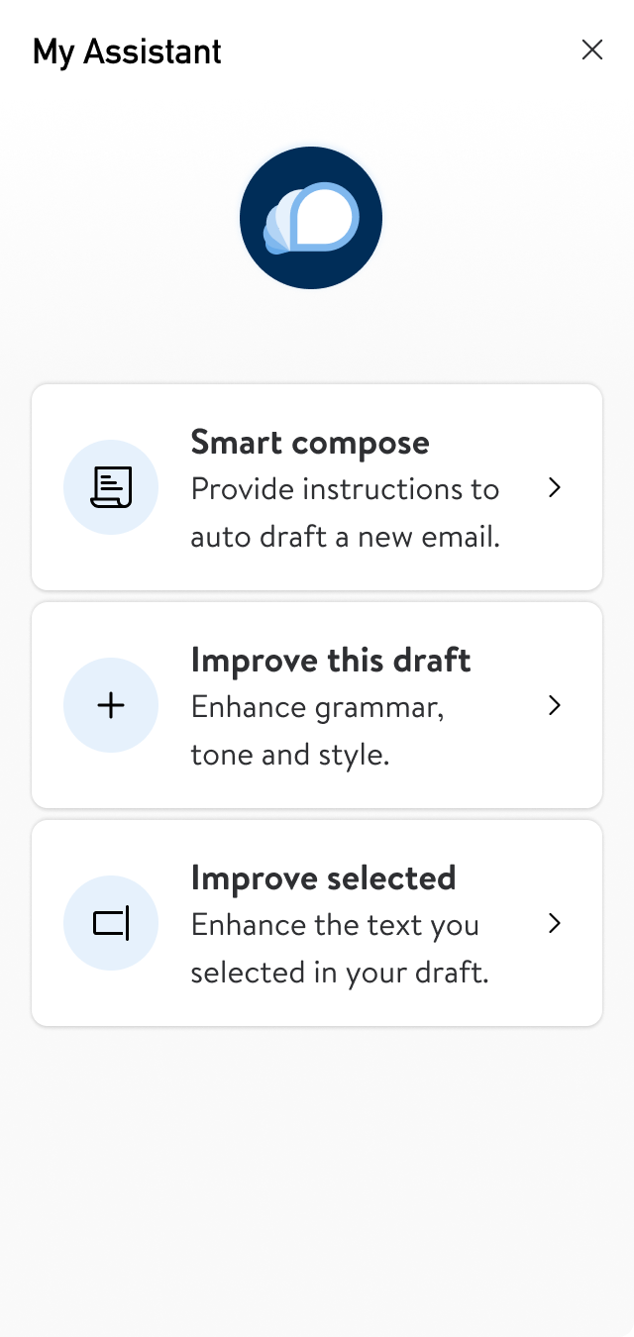
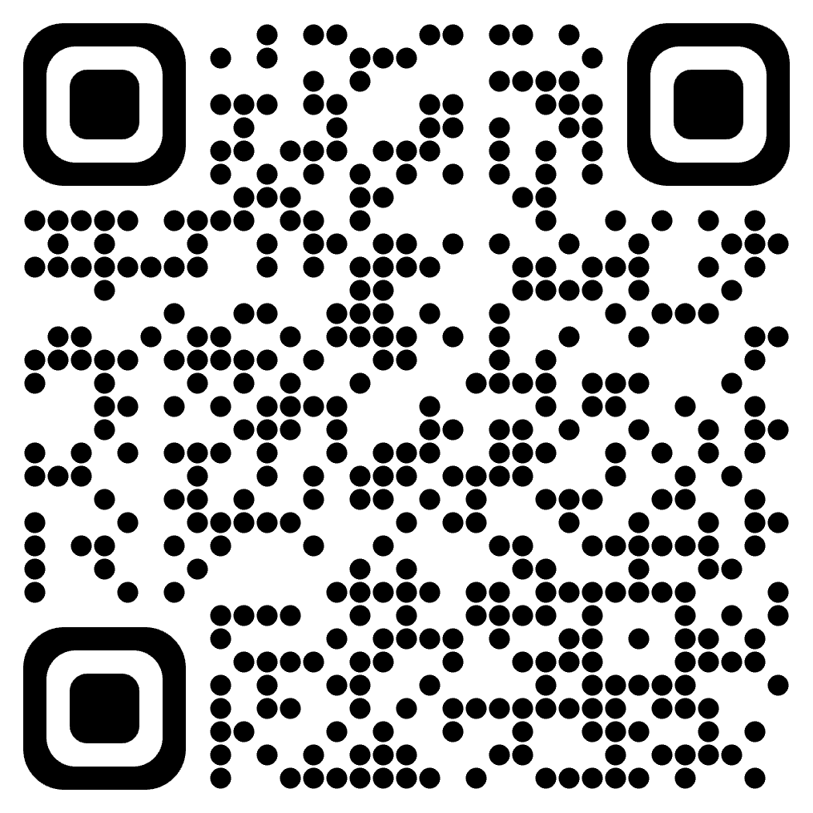
Qyestions
My Assistant link
Photos
https://corporate.walmart.com/newroom/media-library
Brand
https://walmartbrandcenter.lingoapp.com/
Scan QR Code
17
Walmart Confidential
Notes:
Plugin represent a component whereas Experience represent a journey
Get detainis of stores also generate reports and analysis relevant trends.
Learn to prompt teach to get output which is most effective b teaching better prompting.
HMR: Guide user to write better content with Walmart information.

Slide 18
Helpful Links
RESOURCES

Slide 19
MyAssistant- Chrome Extension
Standalone
Me@Campus
Browser Extension
https://myassistant.walmart.com/
https://campus.walmart.com/home
A plugin as side panel of the browser.
20k active weekly users from this experience.
0.5 hr mins avg. time save * 55K home-office associates* 48 weeks avg. * $52 avg. cost ~ $6,86,40,000

Slide 20

MyAssistant- Engineering Excellence
6. Satisfaction is the goal of each experience.
1. Represent the journey of a user in MyAssistant.
5. Role Based enablement.
2. Zero plugin or can use one or multiple plugins.
4. Easy uplift will happen when plugin will evolve to Agent.
3. Design to solve specific user problem.
Notes:
1. developed from chat GPT 4.0
2. Isolate the risks: Compartmentalize the risks for individual tools/plugin-based services. A bad agent could be dropped from the library.
Mobilize a broader developer community: Develop flagship plugins but also enable a framework to onboard plugins developed by other teams.
4. RBAC: Plugins for specific requirements from a group of people. Ex: Learning content developers need image/audio generation (computationally expensive) capabilities, the plugin service will be enabled and visible to only LCDD team users.
5. User Choice: Users will be contextualized when they enter/load the plugin. Everything already integrated is not a better fitment here rather help to user prior knowledge what they want.
6 Separate terms and conditions: Users to understand and agree with the risks for incomplete answers or information before they use the plugins.
Experience represents journey of an user as well.

Slide 21
MyAssistant- Access Points
Standalone
Me@Campus
https://myassistant.walmart.com/
https://campus.walmart.com/home

Slide 22
Experience - ASK My Page
Summarizing and identifying key points from a webpage
Creating a list of FAQs tailored to the web page content
Responding to user inquiries related to the web page
Proposing engaging prompts or actions inspired by the web page
ASK MY PAGE
Notes:
Plugin represent a component whereas Experience represent a journey
Get detainis of stores also generate reports and analysis relevant trends.
Learn to prompt teach to get output which is most effective b teaching better prompting.
HMR: Guide user to write better content with Walmart information.

Slide 23
Experience
ASK ME DOC
ASSOCIATE CAN HAVE NATURAL LANGUAGE QUESTION ANSWERING ON UPLOADED DOCUMENTS AND GET INSIGHT
LEARNT TO PROMPT
PROVIDE PROMPT TRAINING EXPERIENCE AND FEEDBACK THOUGH CONVERSATIONAL APPROACH
CREATE PERFORMANCE GOAL
ASSOCIATES CAN USE AI TO CREATEPERFORMENCE GAOLS.
PEOPLE DATA EXPERIENCE
THIS EXPERIENCE WILL PROVIDE USERS WITH VALUABLE INSIGHTS ON STORES AND ASSOCIATES
HELP ME WRITE
PROVIDE WALMART KNOWLEDGE WORKERS TO HAVE A BACK-AND-FORTH CONVERSATION AND AND EVENTUALY HELP TO WRITE CONTENT.
ONE WALMART SEARCH
SEARCH WALMART AEM INFORMATION THROUGH CHAT.
Notes:
Plugin represent a component whereas Experience represent a journey
Get detainis of stores also generate reports and analysis relevant trends.
Learn to prompt teach to get output which is most effective b teaching better prompting.
HMR: Guide user to write better content with Walmart information.

Slide 24
MyAssistant- Access Points
Standalone
Me@Campus
https://myassistant.walmart.com/
https://campus.walmart.com/home

Slide 25
MyAssistant- Chrome Extension
Standalone
Me@Campus
Browser Extension
https://myassistant.walmart.com/
https://campus.walmart.com/home
A plugin as side panel of the browser.

Slide 26

MyAssistant- Relevance
aa
Instant, accurate responses to associate’s queries about Walmart policies.
11,000 Users
Quick and valuable comprehension for lengthy documents.
Granular business insights using its inbuilt business intelligence capability.
An AI-powered chatbot integrated with Walmart knowledge and multi-faceted capabilities designed for Walmart associates.
Personalized chat experience using its natural language interface .

Slide 27


MyAssistant- Initial challenges
How To Onboard Walmart policy In LLM model ?
Plugin
Agent
Notes:
ChatBot and GenAI market available model already exist but bringing Walmart knowledge was the challenge.

Slide 28
Plugin & Agent
Plugin
Agent
An opt-in approach requires associates to explicitly select a component in order to include it as part of the conversation.
A smarter approach involves calling a component implicitly based on the user's question when it is needed.

Slide 29
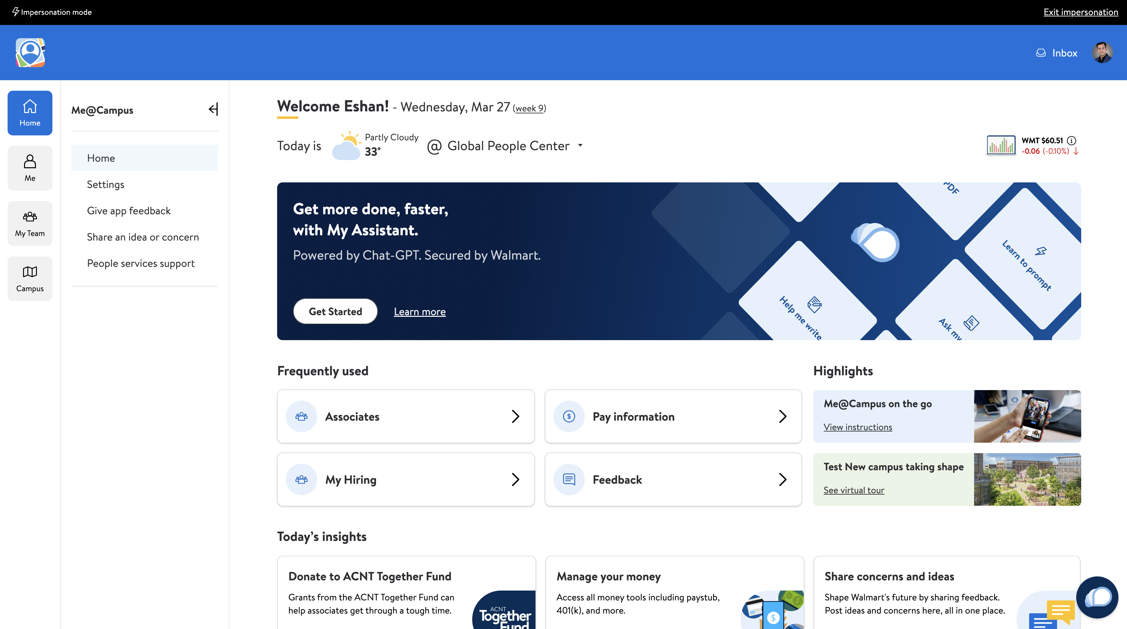
MyAssistant- Access Points
Standalone
https://myassistant.walmart.com/
Me@Campus
https://campus.walmart.com/home
Me@Campus is a Platform APP where multiple “Mini Apps” Exist.
“Mini Apps” are nothing But a self-sufficient Micro services.

Slide 30
MyAssistant- Chrome Extension
Standalone
Me@Campus
Browser Extension
https://myassistant.walmart.com/
https://campus.walmart.com/home
A plugin as side panel of the browser.
20k active weekly users from this experience.
0.5 hr mins avg. time save * 55K home-office associates* 48 weeks avg. * $52 avg. cost ~ $6,86,40,000

Slide 31
MyAssistant Evolution
Plug in will be evolved to Agent and successfully promoted to perform necessary actions without less user intervention.
Short Term
Plugins will be explicitly called by the user
Intermediate Term
Users will be asked to call plugin when needed
Long term
Plugins will be implicitly called without user’s intervention
Notes:
First the user need to call plugin, then Myassitant will recommend the plugin and finally it will call plugin when required

Slide 32
World of Plugins
DOC AI
DOCUMENT ANALYTICS PLUGIN ALLOW USER TO UPLOAD AND QUERY THEIR DOCUMENT
PROMPT MODIFICATION
HELP TO WRITE APPROPRIATE PROMPT TO USER
CONVERSATIONAL TRANSL.N
Translate spoken words from one language to another in real-time
ASSOCIATE BENEFIT
ENABLE THE NEXT GENERATION BENEFITS SELF-SERVICE FOR ASSOCIATES AND ACCESS INFORMATION IN NATURAL LANGUAGE
POLICY GUIDE
BASED ON POLICY RELETED QUESTIONS PROVIDE CLEAR AND CONCISE ANSWERS
POLICY GUIDE
BASED ON POLICY RELETED QUESTIONS PROVIDE CLEAR AND CONCISE ANSWERS
Notes:
Doc AI:
This Plugin leverage LLM and and makes document analysis and information retrieval a breeze for me@capus users.
users can easily generate summaries from lengthy zoom meeting transcripts, engaged in interactive Q&A sessions with large files like white papers, PRDs and reports, and even automatically draft emails using information extracted from relevant PDF documents.
it streamlines PDF document analysis as well/
Associate Benefits
Associates can provide about their yearly deductibles for each major medical plans, Yearly annual check up packages, dental cleavage and eye-sight check-ups etc, Also this plugin has features like upload document and get answer through QA,
Career exploration:
Associates can search job based on particular Geographic location like Bentonvelle or Bangalore, based on role like “data scientist, Store Manager,
Associate Search: User can find in natural languages question like “all available datascientists in bangalore?” “List of product managers in Chennai”, Store as well In a store who can decorate cakes?”

Slide 33
Experience
ASK ME DOC
ASSOCIATE CAN HAVE NATURAL LANGUAGE QUESTION ANSWERING ON UPLOADED DOCUMENTS AND GET INSIGHT
LEARNT TO PROMPT
PROVIDE PROMPT TRAINING EXPERIENCE AND FEEDBACK THOUGH CONVERSATIONAL APPROACH
CREATE PERFORMANCE GOAL
ASSOCIATES CAN USE AI TO CREATEPERFORMENCE GAOLS.
Experience
Curated Flow designated to solve specific user problem
PEOPLE DATA EXPERIENCE
THIS EXPERIENCE WILL PROVIDE USERS WITH VALUABLE INSIGHTS ON STORES AND ASSOCIATES
HELP ME WRITE
PROVIDE WALMART KNOWLEDGE WORKERS TO HAVE A BACK-AND-FORTH CONVERSATION AND AND EVENTUALY HELP TO WRITE CONTENT.
ONE WALMART SEARCH
SEARCH WALMART AEM INFORMATION THROUGH CHAT.
Experience are how associates find Walmart information in My Assistant
Notes:
Plugin represent a component whereas Experience represent a journey
Get detainis of stores also generate reports and analysis relevant trends.
Learn to prompt teach to get output which is most effective b teaching better prompting.
HMR: Guide user to write better content with Walmart information.

Slide 34

MyAssistant- A Realtime Example
WebPage AI
DOCUMENT ANALYTICS PLUGIN ALLOW USER TO UPLOAD AND QUERY THEIR DOCUMENT
Ask This Page
DOCUMENT ANALYTICS PLUGIN ALLOW USER TO UPLOAD AND QUERY THEIR DOCUMENT
take the persona of a graphic designer and generate a 3d icon which signifies authorisation. The icon should be modern.
Notes:
1

Slide 35



MyAssistant- Arch.

Slide 36
MyAssistant- Engineering Excellence
6. separate terms and conditions for each plugin.
1. Adopted from ChatGpt 4.0
6. Satisfaction is the goal of each experience.
1. Represent the journey of a user in MyAssistant.
5. user choice: Contextualize when user enter/load plugin.
5. Role Based enablement.
2. Cut-off the risk of individual tools.
2. Zero plugin or can use one or multiple plugins.
4. RBAC support – plugins for certain job role.
4. Easy uplift will happen when plugin will evolve to Agent.
3. Independent tool deployed as API.
3. Design to solve specific user problem.
Notes:
1. developed from chat GPT 4.0
2. Isolate the risks: Compartmentalize the risks for individual tools/plugin-based services. A bad agent could be dropped from the library.
Mobilize a broader developer community: Develop flagship plugins but also enable a framework to onboard plugins developed by other teams.
4. RBAC: Plugins for specific requirements from a group of people. Ex: Learning content developers need image/audio generation (computationally expensive) capabilities, the plugin service will be enabled and visible to only LCDD team users.
5. User Choice: Users will be contextualized when they enter/load the plugin. Everything already integrated is not a better fitment here rather help to user prior knowledge what they want.
6 Separate terms and conditions: Users to understand and agree with the risks for incomplete answers or information before they use the plugins.
Experience represents journey of an user as well.

Slide 37







MyAssistant- Functional Excellence
Toxicity Moderation filter
Human-like Translation
Gen AI Integrated Document Insights
Chat History Enabled
Walmart Privacy
Features
Maintain PII policy

Slide 38
MyAssistant- Functional Excellence
Upload and ask questions on any document
Personalized Experience
Domain specific Information
Quick, intuitive answer
Marketplace
Hosted
Advantages
Predesigned Questions

Slide 39
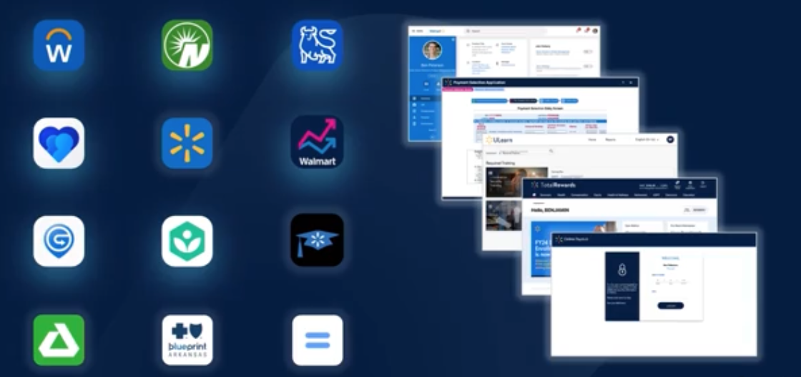

Building Philosophy – Me@Campus
Unified
Consumer Grade
Simplified
“unified experience instead of fragmented experience”
same philosophy for customers as well as associates-
“utmost satisfaction”
“making the complex simple”
-Walmart focus Power of people
Notes:
[^1]There were multiple apps in Walmart ecosystem earlier, for serving dedicated business processes and Me@Campius in a mission, to give a common platform for all those apps.
[^2]The Me@Campus is consumer-grade; As we know, in the Ecommerce world Walmart everyday serves millions of customers and always focuses on customers first. , now Me@Capus is on a mission to bring the same satisfaction to its associates.
[^3]A massive company like Walmart, of-course it has different complex processes, which pragmatically influence Walmart associate's day to day life which leads towards more productivity.

Slide 40

My Assistant – Mission and Vision
Short Term Goal
Long Term Goal
To enhance My Assistant by integrating the following capabilities
Support to multiple document formats like .XLS
Enabling multiple uploads of PDF in a single conversation chain
Provisioning cross-query analytics engine across multiple documents.
To make My Assistant - a one-stop assistant by integrating the business intelligence capabilities of:
People Bot – A virtual assistant that enables users to get instant and insightful answers about our people and organization.
Workday bot – A chatbot designed for providing a seamless job transaction for managers and associates.
A unified, world-class virtual assistant for Walmart associates
Notes:
Short term goal of MyAssitant is widening it’s exiting capabilities like
Long term Goal, In Walmart eco system there are multiple bots exists which capable of handling their own task, MyAssistant is going to provide a unique gatway of those bots.

Slide 41



Me@Campus -A brief introduction
As of now 50,000 Home Office associates are user of MyAssistant .The Product already rolled out for US and International( Canada, Mexico, Chellie) associates and will be rolled out for IDC associates soon.
Me@Campus
FOR ALL WAL MART HOME-OFFICE ASSOCIATES AN UNIQUE PLATFORM EXIST - which provide a one stop destination of information what they need most.
Notes:
[^1]For All Walmart home office Associates, a unique platform exists which provides a one-step destination of information on what each associates need most.
The name of the application is Me@campus.
The application exists in both forms as a mobile app as well as a desktop version

Slide 42

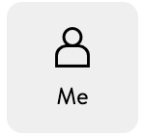
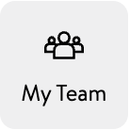
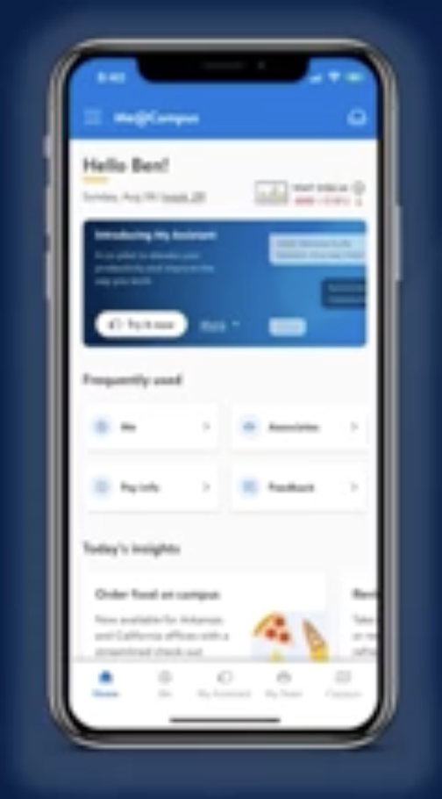



Me@Campus –Accessibility
Desktop App.
Mobile App
Notes:
Me@Campus is accessible through Mobile and Desktop as well and it has 5 major sections.

Slide 43
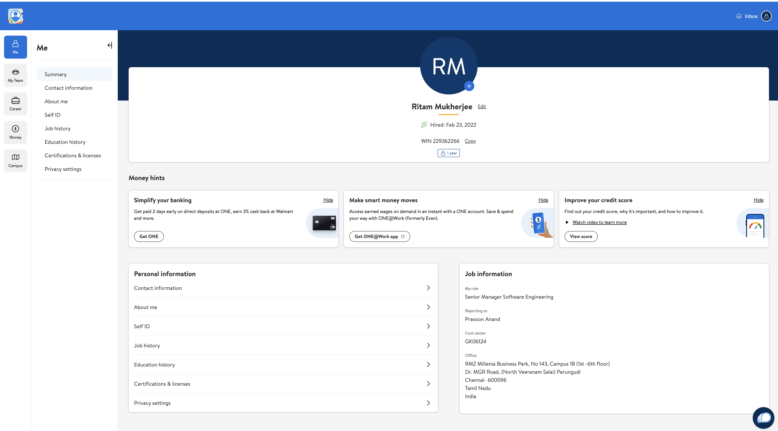
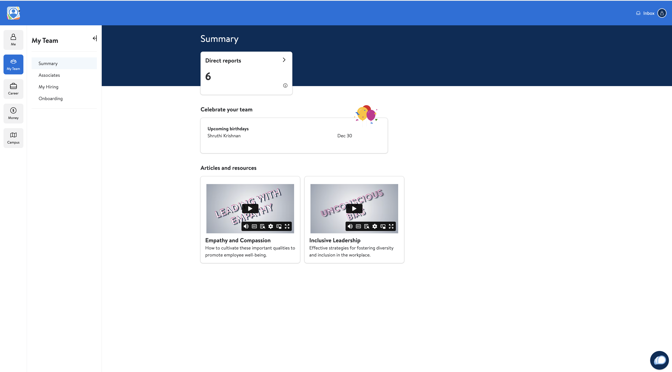

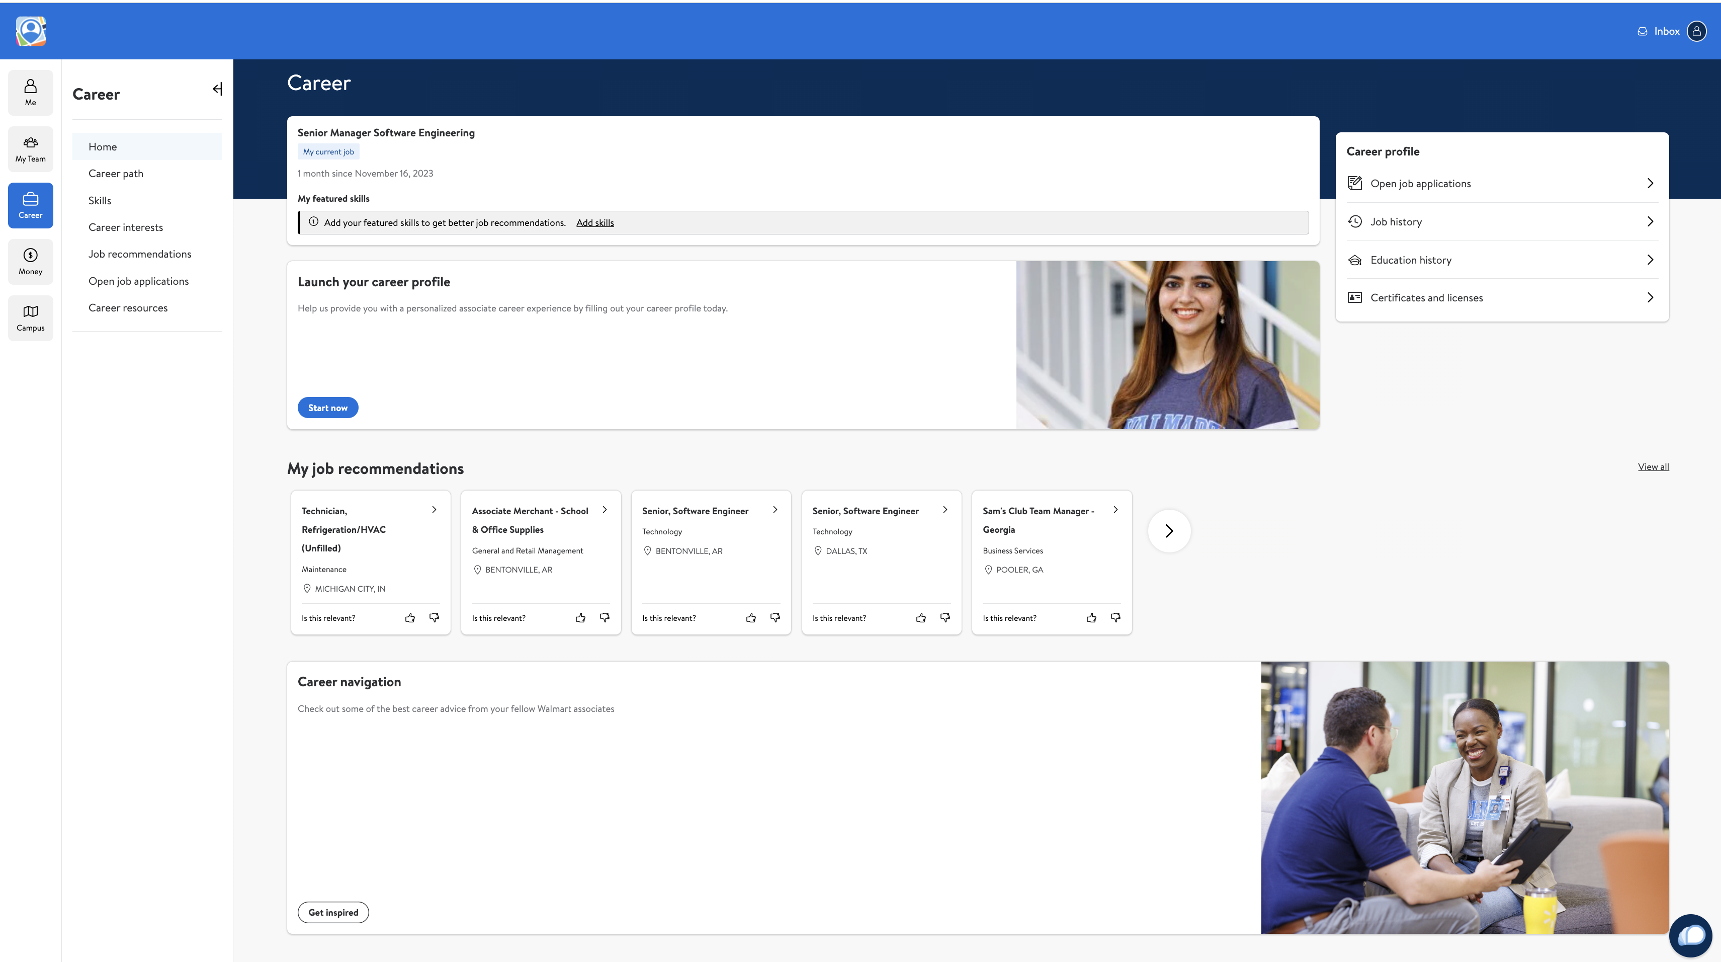
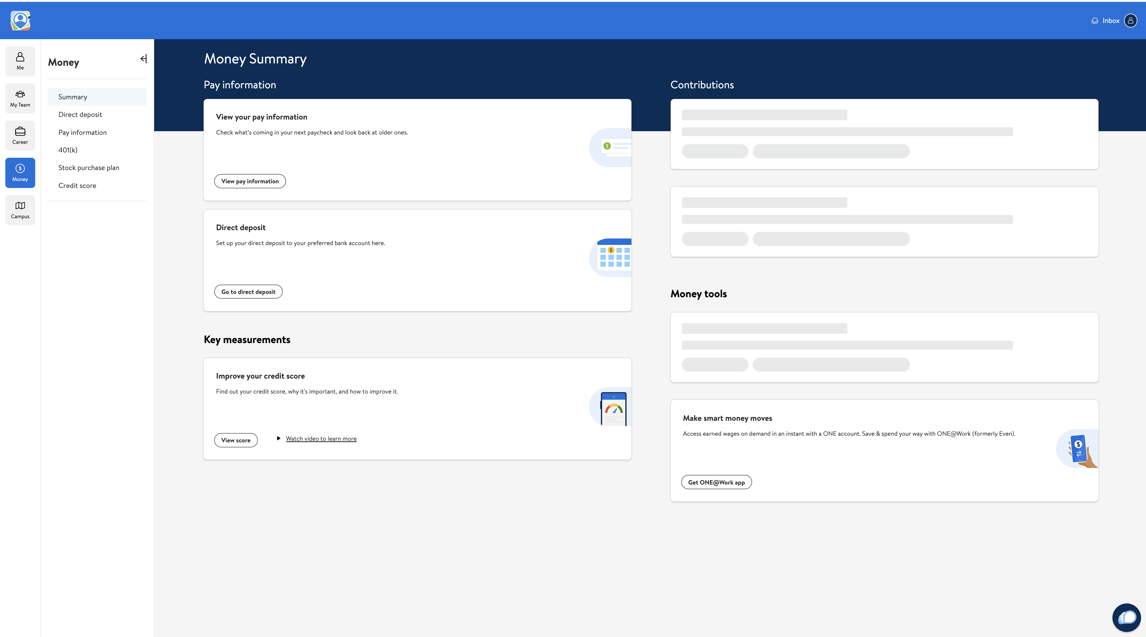
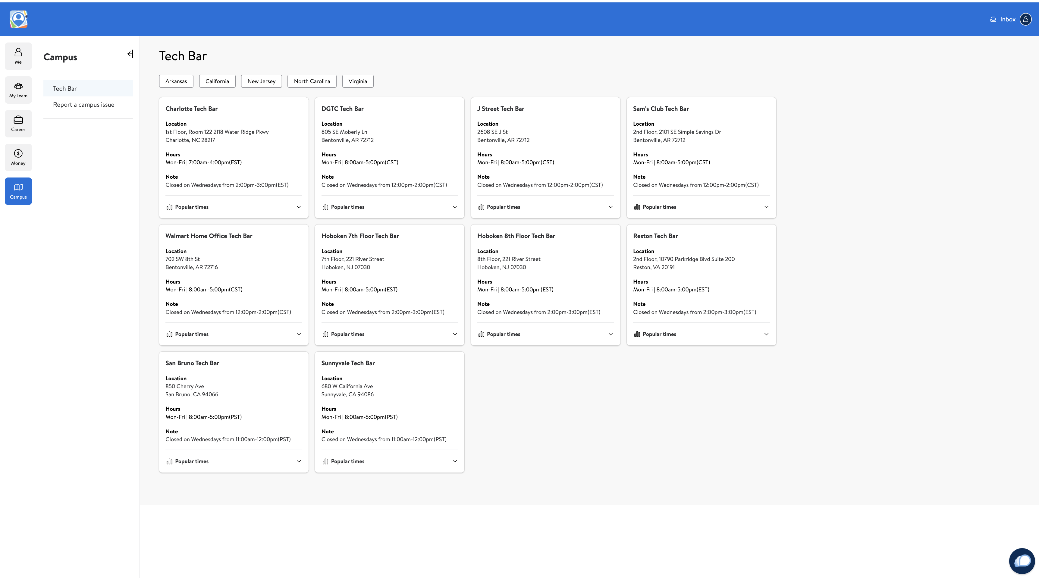
Me@Campus – Deep Dive
Notes:
ME section has personal information, job information, job history etc.
My team give details of their team, onboarding details and manager can see their onboarding details
Carrier feature Walmart associates can create their own profile, get tailor made job notification also they can add skill teir skill.
Allow associates to manage their money – take care personal finances leveraging Walmart Eco- System.
Campus section navigate to a campus, select a particular campus, navigate to a meeting room, and reserve.

Slide 44
MyAssistant – Landing Point
In Platform APP there are Multiple Mini Apps Exist.
Mini Apps are nothing But a self-sufficient Micro services.
Notes:
At Me @Campus page we can see many vuttons and links, which are called Mini-APPs

Slide 45




Who can get benefit from MyAssistant?
Manager
Associate
Human Resource
Resume Search
Onboarding
Interview Recommendation
Leave approval
Skill set mapping
Policy find
Mentoring others

Slide 46
Helpful Links
RESOURCES
Photos
https://corporate.walmart.com/newsroom/media-library
Brand
https://walmartbrandcenter.lingoapp.com/
Scan QR Code
My Assistant link

Slide 47
Slide Title
HEADING
Header
Header
We aim to build a better world — helping people live better and renew the planet while building thriving, resilient communities.
We aim to build a better world — helping people live better and renew the planet while building thriving, resilient communities.

Slide 48
A Special Event
AUGUST 2023

Slide 49
Global People Town Hall
August — 2023

Slide 50
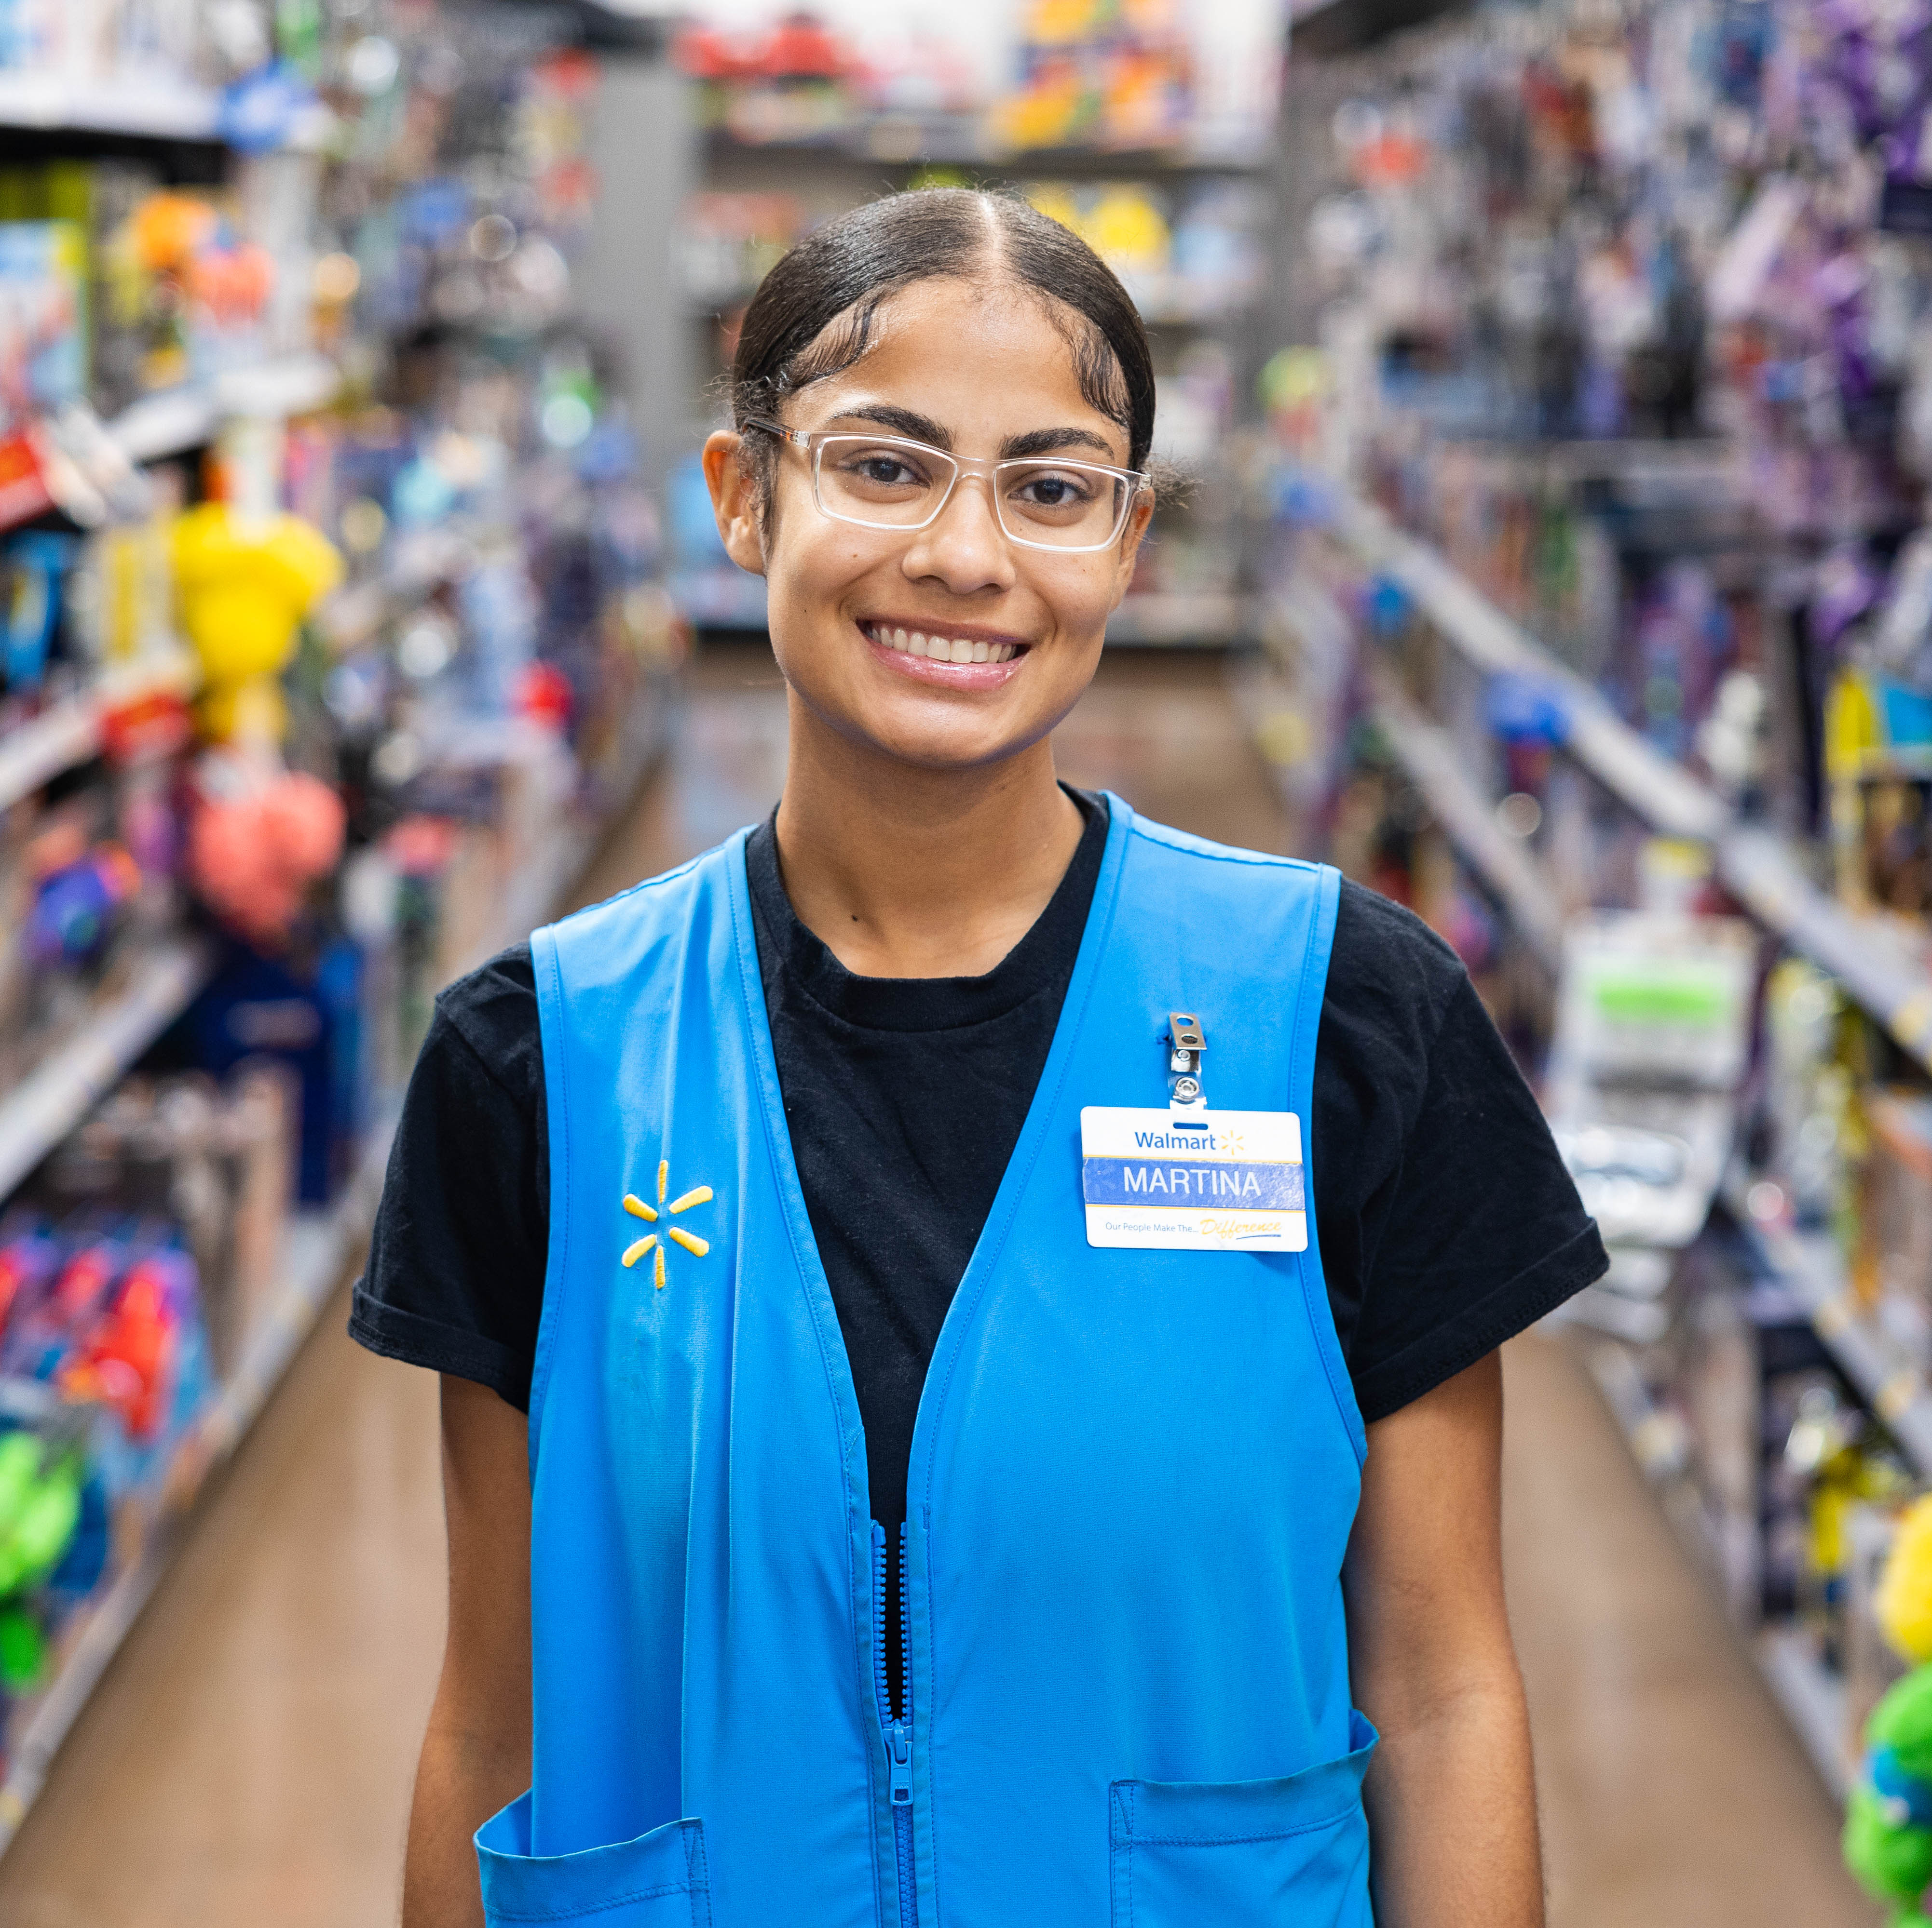
Global People Town Hall
Project/Initiative
August — 2023

Slide 51
Slide Title
HEADING
TOPIC 1
TOPIC 2
TOPIC 3
We aim to build a better world — helping people live better and renew the planet while building thriving, resilient communities.
For us, this means working to create opportunity, build a more sustainable future, advance diversity, equity and inclusion and bring communities closer together.
We aim to build a better world — helping people live better and renew the planet while building thriving, resilient communities.
For us, this means working to create opportunity, build a more sustainable future, advance diversity, equity and inclusion and bring communities closer together.
We aim to build a better world — helping people live better and renew the planet while building thriving, resilient communities.
For us, this means working to create opportunity, build a more sustainable future, advance diversity, equity and inclusion and bring communities closer together.

Slide 52
Side Photo Slide
HEADING
Heading
Communicate everything you possibly can to your partners. The more they know, the more they'll understand. The more they understand, the more they'll care. Once they care, there's no stopping them.

Slide 53
Slide Title
HEADING
Heading
An AI-powered chatbot integrated with Walmart knowledge and multi-faceted capabilities designed for Walmart associates.

Slide 54
MyAsssitant Foundation
HEADING

Slide 55
New Section
HEADER

Slide 56
Slide Title
HEADING

